Slide 1

Generation of saw-tooth beam at AWA
(longitudinal density shaping using EEX)
International ICFA mini-workshop on
Nonlinear dynamics and Collective effects in particle beam physics
Arcidosso, Italy / 19-22 September 2017
Gwanghui Ha
2017. 09. 21

Slide 2
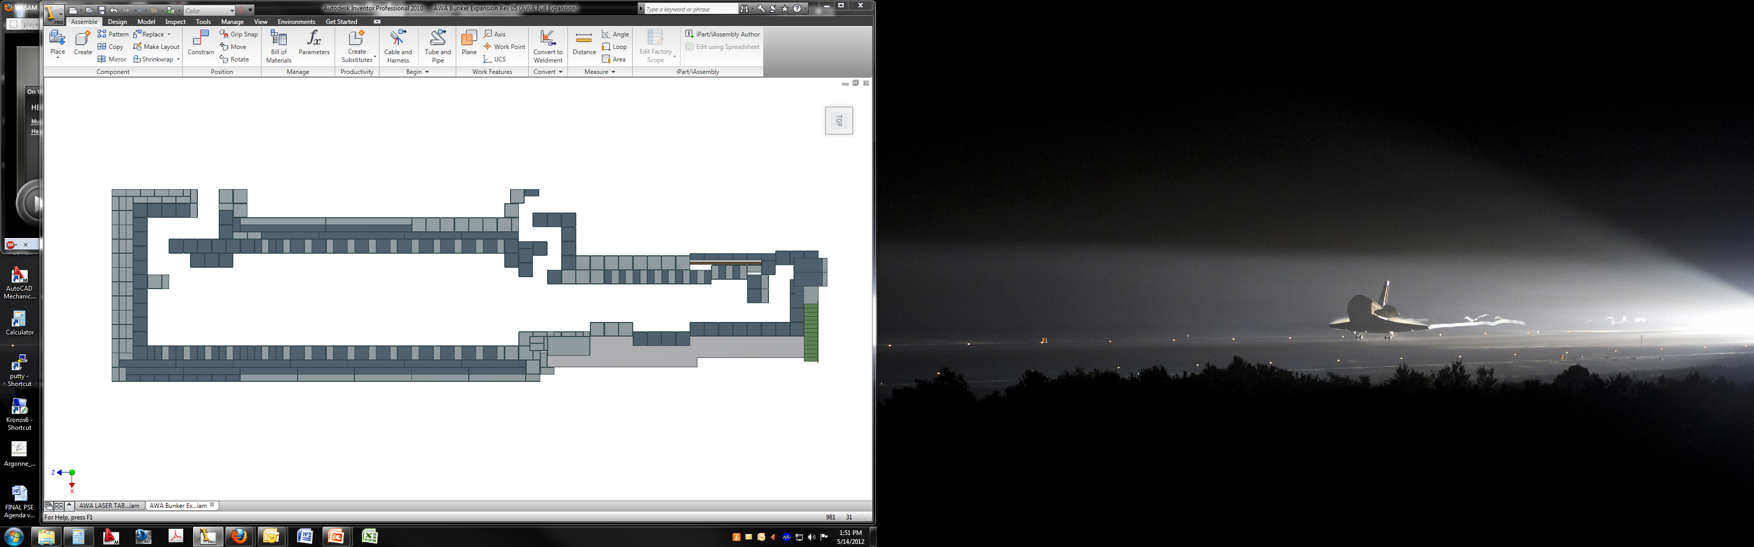
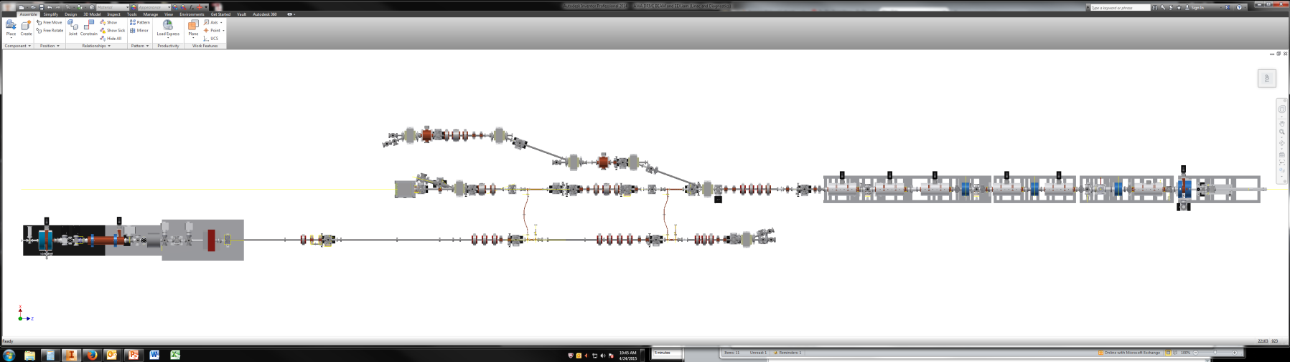
Argonne Wakefield Accelerator and collaborators
Collaboration:
Argonne National Laboratory, HEP: | J. G. Power, M. Conde, W. Gai
Argonne National Laboratory, APS: | Zholents, K. –J. Kim, Y. –E Sun
FNAL/NIU: | P. Piot
Euclide Techlabs LLC: | C. Jing, S. Antipov, A. Kanareykin
Pohang Accelerator Laboratory: | G. Ha
*Supported by U.S. DOE High Energy Physics and Basic energy science

Slide 3
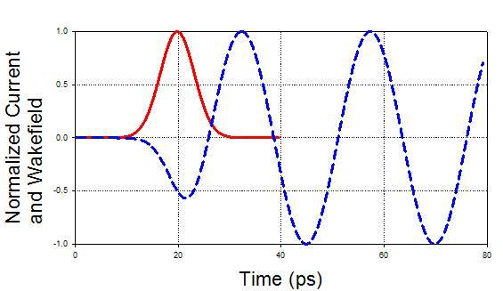

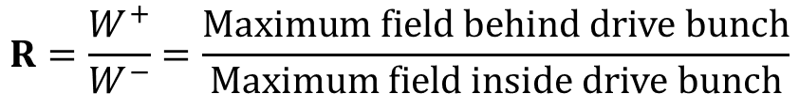


Longitudinal manipulation? What is the benefit?
Drive bunch
Witness bunch
$$W^{+}$$
Dielectric
$$W^{−}$$
$$R=\frac{W^{+}}{W^{−}}=\frac{Maximum field behind drive bunch}{Maximum field inside drive bunch}$$
R<2 for symmetric bunches
(Fundamental theorem of weakefield)
Assume $N=Z/λ=2$
0
2
4
6
9
12
K. L. F. Bane, SLAC-PUB (1985)
F. Lemery, PRAB 2015

Slide 4
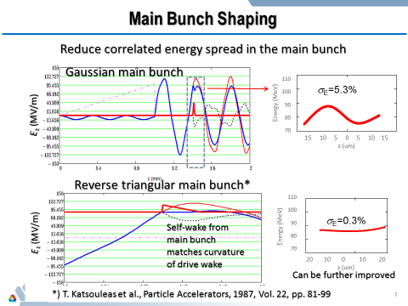
Applications of longitudinal manipulations
Zholents, FEL2014 Energy spread control
C. Mitchell, PRSTAB 16, 060703
CSR suppression
Y. –E Sun, PRL 105, 234801
Train generation

Slide 5


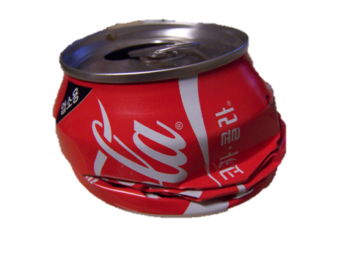


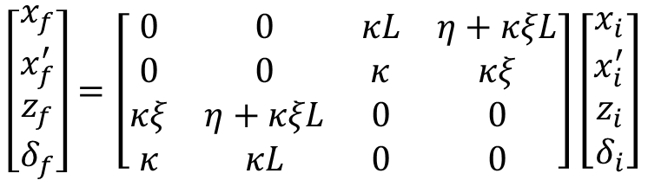
Principle of double dogleg EEX beamline
Transport Matrix
Position → Momentum
$$\left[\begin{matrix}x_{f} \\ x_{f}^{′} \\ z_{f} \\ δ_{f}\end{matrix}\right]=\left[\begin{matrix}0 & 0 & κL & η+κξL \\ 0 & 0 & κ & κξ \\ κξ & η+κξL & 0 & 0 \\ κ & κL & 0 & 0\end{matrix}\right]\left[\begin{matrix}x_{i} \\ x_{i}^{′} \\ z_{i} \\ δ_{i}\end{matrix}\right]$$
Ez
By
x
z
Final longitudinal properties are only determined by initial horizontal properties
$$Δx′=κΔz$$
$$Δz_{2}=Δz+κηΔz$$
Momentum → Position
x
By
z

Slide 6
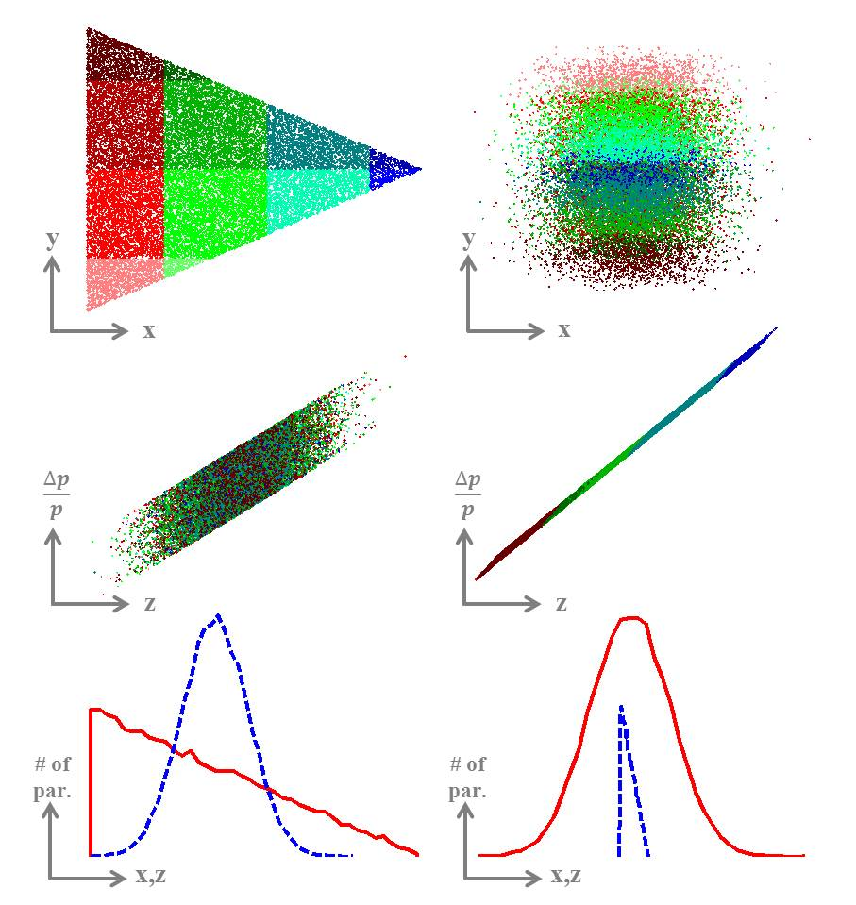
Property exchange and bunch shaping
Horizontal profile
Current profile

Slide 7
“Nonlinear” and “Collective” effect on EEX and EEX Shaping

Slide 8
Perturbation and their mitigation
$$z_{f}=κξx_{o}+\left(η+κξ\left(L+L_{D}+\frac{L_{c}}{4}\right)\right)x_{0}^{′}$$
$$+\frac{L_{c}}{4}κξz_{0}+\frac{L_{c}}{4}κξ^{2}δ_{o}$$
$$+ C_{nm}X_{n}X_{m} + ξΔδ$$
Second order terms
Collective effects
ideal terms
Emittance related term
Thick-lens term
x-x′
z-δ
Perturbation on the position
Overlap of position
EEX

Slide 9
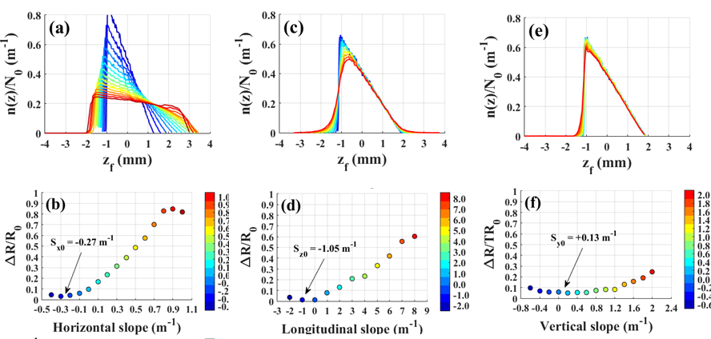


Slope-control method to mitigate the second order effect
$$Δz_{f}=C_{1}x_{0}^{2}+C_{2}x_{0}x_{0}^{′}+C_{3}{x_{0}^{′}}^{2}$$
$$\left\langle ζ\right\rangle =\left(C_{1}+C_{2}S_{x_{0}}+C_{3}S_{x_{0}}^{2}\right)\left\langle x_{0}^{2}\right\rangle$$
$$\left\langle ζ^{2}\right\rangle =\left(C_{1}^{2}+2C_{1}C_{2}S_{x_{0}}+\left(2C_{1}C_{3}+C_{2}^{2}\right)S_{x_{0}}^{2}+2C_{2}C_{3}S_{x_{0} }^{3}+C_{3}^{2}S_{x_{0}}^{4}\right)\left\langle x_{0}^{2}\right\rangle$$
G. Ha et al, PRAB (2016)

Slide 10
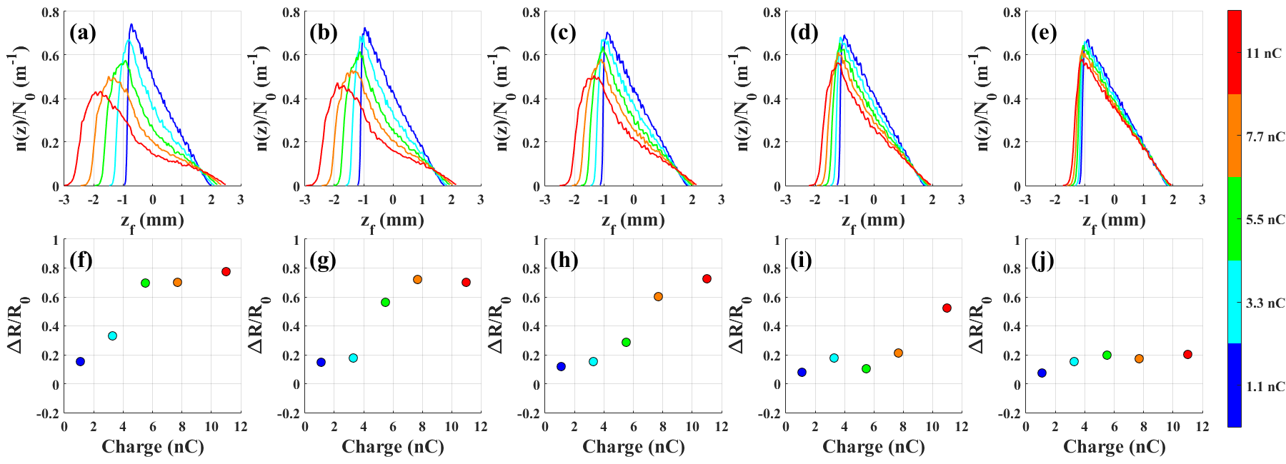



Asymmetric dogleg method to mitigate collective effects
$$Δδ_{1}$$
$$Δδ_{2}$$
$$Δδ_{3}$$
$$Δz_{f}=ξ_{2}\left(1+κη^{∗}\right)Δδ_{1}+ ξ_{2}Δδ_{2}+ξ_{2}^{∗}Δδ_{3}$$
$$Δz_{f}=ξ_{2}\left(1+κη^{∗}\right)Δδ_{1}+ ξ_{2}Δδ_{2}+ξ_{2}^{∗}Δδ_{3}$$
G. Ha et al, PRAB (2016)

Slide 11
Biggest hurdle…
EEX beamline has to just exchange the transverse and longitudinal emittance, but …
~100 micron for z and ~200 micron for x
10 micron for x and 50 micron for z initially
Emittance is exchanged, but
there is huge emittance growth from CSR

Slide 12
Efforts to reduce emittance growth from CSR
Emittance after double EEX
Charge: 5 nC
Energy: 50 MeV
Asymmetric dogleg beamline
(no shielding)
Normal beamline
(no shielding)
(Shielding, all gap: 5 cm)
Beam optim
(Shielding, partial gap: 2 cm)
(Shielding, gap: 2 cm)
beam optim
(Shielding, all gap: 2 cm)
No growth
SC + 2nd order growth (SC dominant)
G. Ha et al, FEL (2017)

Slide 13
How far we can go with 100 pC and 1 micron emittance?
with collective effect, partial gap 2 cm
(final: 1.15 micron for 0.5 mm)
with collective effect,
1 cm gap
(final: 1.04 micron)
with collective effect,
all gap 2 cm / 5 degree bending
(final: 1.1 micron for 0.5 mm)
G. Ha et al, IPAC (2017)

Slide 14
Experiment

Slide 15
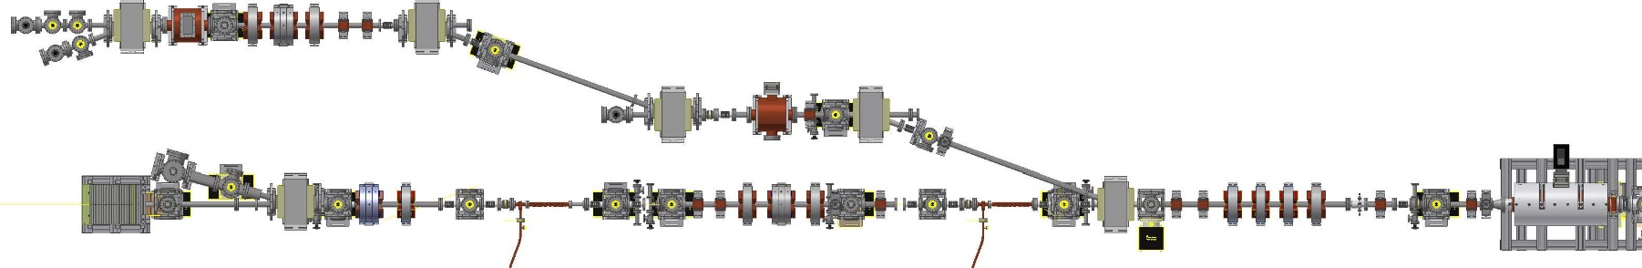



Demonstration of zero-diagonal characteristic
$$Q1=−0.7 T/m$$
$$Q1=0.0 T/m$$
$$Q1=+0.7 T/m$$
Xrms=
10.5 mm
Xrms=
9.1 mm
Xrms=
10.2 mm
Scan
Q1= -0.5 T/m
Q1= 0 T/m
Q1= 0.5 T/m
Zrms=
4.9 mm
Zrms=
3.2 mm
Zrms=
1.4 mm

Slide 16
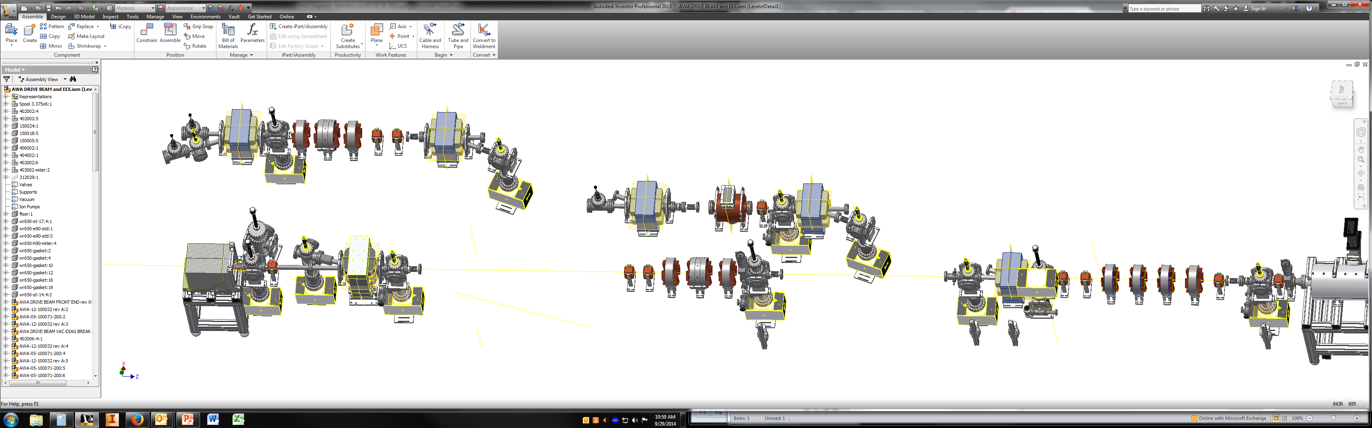
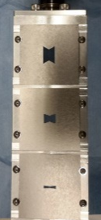
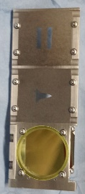
Experiment result – shaping capability
Train
Triangle
Rectangle
Trapezoid
z
z
z
z
Take initial horizontal profile
Take final longitudinal current profile
5 nC / 48 MeV
y
y
y
y
Train
Triangle
Rectangle
G. Ha et al, PRL (2017)
Trapezoid

Slide 17
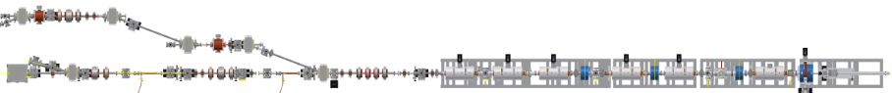
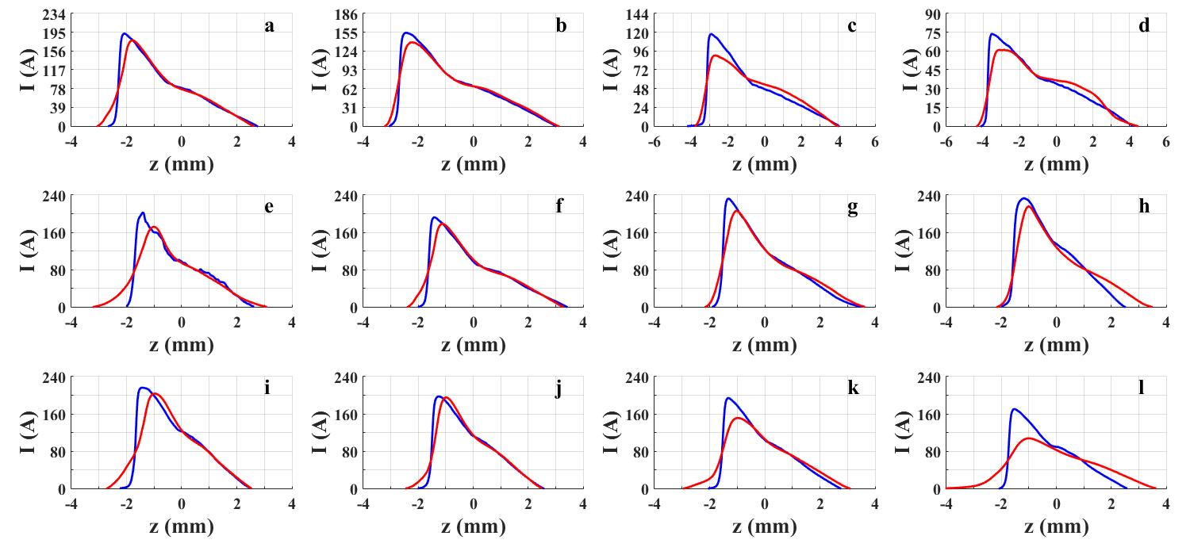
Demonstration of slope control method
z-profile
x-profile
Transverse slope control
Longitudinal slope control
$$s_{x}=0.0 m^{−1}$$
$$s_{x}=0.2 m^{−1}$$
$$s_{x}=0.4 m^{−1}$$
$$s_{x}=0.6 m^{−1}$$
$$s_{y}=−0.6 m^{−1}$$
$$s_{y}=0.0 m^{−1}$$
$$s_{y}=0.2 m^{−1}$$
$$s_{y}=0.6 m^{−1}$$
$$φ=−10°$$
$$φ=−15°$$
$$φ=−25°$$
$$φ=−40°$$

Slide 18
Shaped beam and wakefield interaction
15 cm
1.27 cm
Tunable Gap
(nominal: 2-2.5 mm → 120-130 GHz)
Longitudinal phase space measurement line
Simulated screen images at the end
TDC
Q
Q
dipole
Q. Gao’s thesis work
(from Tsinghua University)
Structure out
Structure in

Slide 19
Shaped beam and wakefield interaction
15 cm
1.27 cm
Tunable Gap
(nominal: 2-2.5 mm → 120-130 GHz)
Measured longitudinal phase space
World record!
TR of 5.5
Q. Gao’s thesis work
(from Tsinghua University)

Slide 20
Planned EEX Application experiments

Slide 21
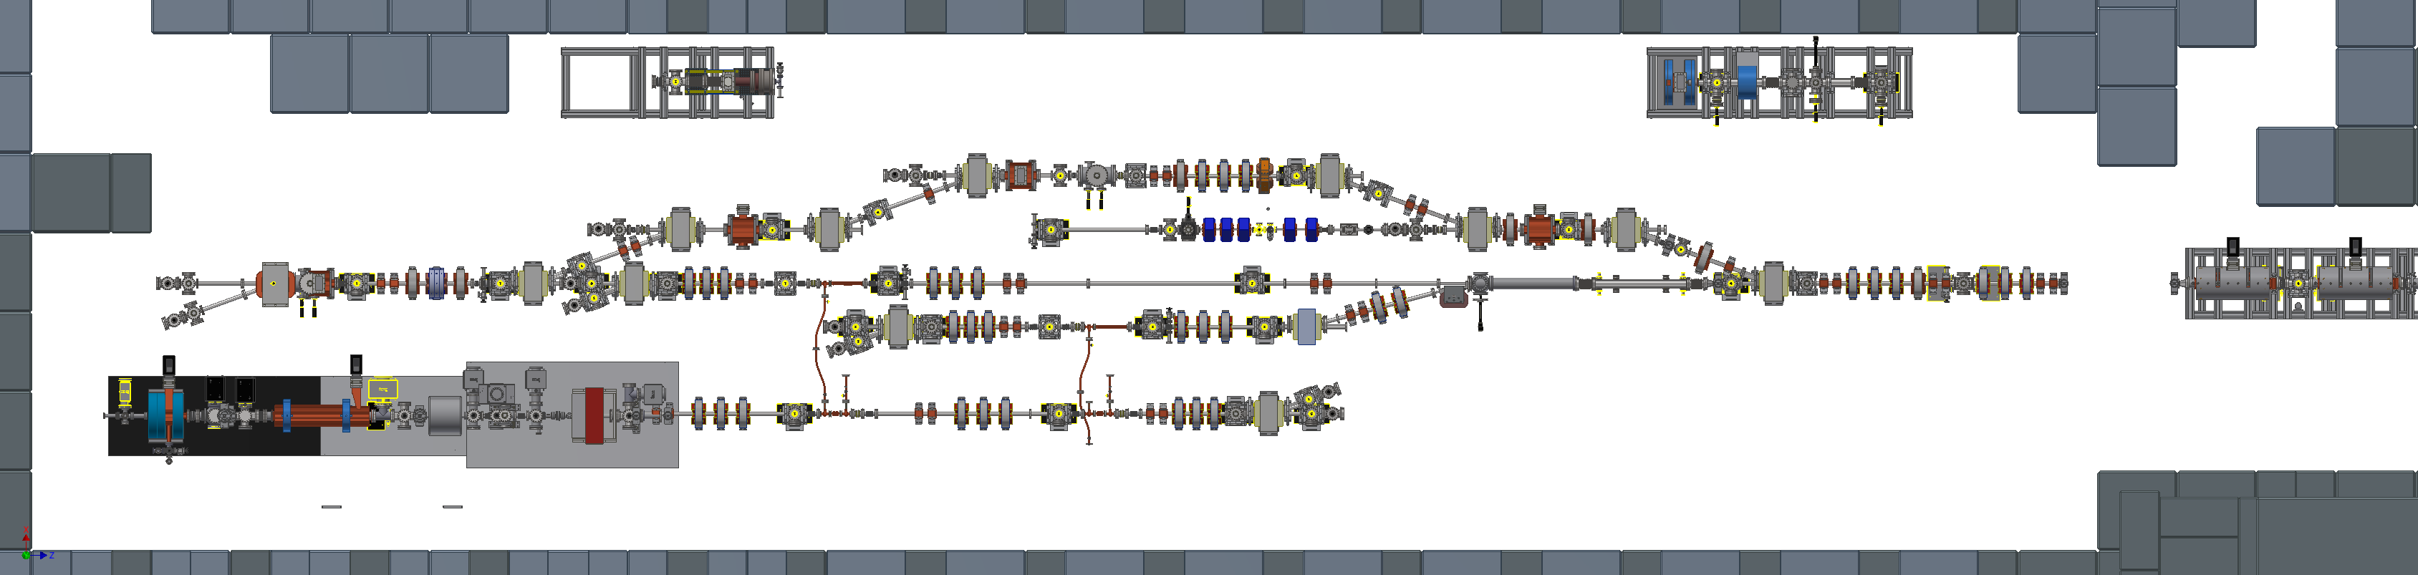
Double EEX beamline configuration
Bunch compression
Double horn treatment
Tunable gap
for shielding
Diagnostics
Adjust longi. chirp at the end
Adjust compression ratio
Trans. control
Dielectric/Plasma
Mask
Longi. control
Bunch shaping
Transverse modulation
Tunable train generation
Longitudinal modulation
Frequency up/down shift

Slide 22
Current profile shaping with double EEX beamline
③
②
①
Not optimized triangle with head
Optimized triangle with head
Single triangle
*Vertical is arbitrarily scaled unit not MV/m
4.871
Ideal transformer ratio for N=1.95
Doorstep | 11.7
Quadratic | 9.16
SingleTriangle | 6.126
-0.484
20 ps
R=10.06
G. Ha et al, IPAC (2017)

Slide 23

Tunable train generation using EEX and magnet array
This separation and R51, R52, xslope determine the final longitudinal spacing.
Microbunch: 300 $μm$ FWHM
Spacing: 2.2 mm ($≅$ 7.3 ps)

Slide 24
Frequency upshift using double EEX
“Is it doable with 800 nm?” and “how to preserve the quality” are the issues.
But, definitely downshift is doable at least at this THz region.
Initial long. phase space
Freq: 3.74 THz
Final long. phase space
Freq: ~0.3 THz
0.2-0.3 ps
~3 ps
weakest compression
weaker compression

Slide 25
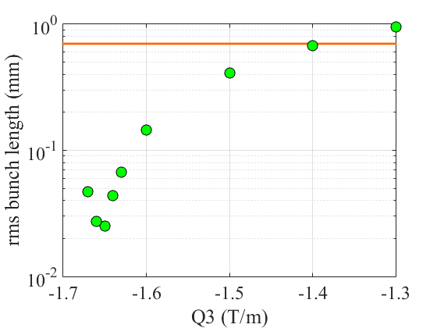
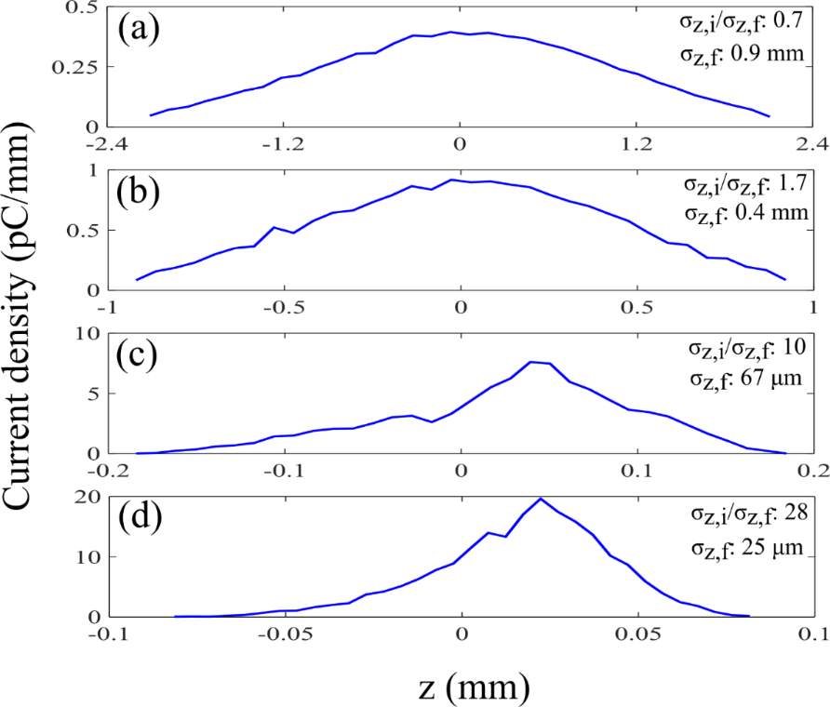
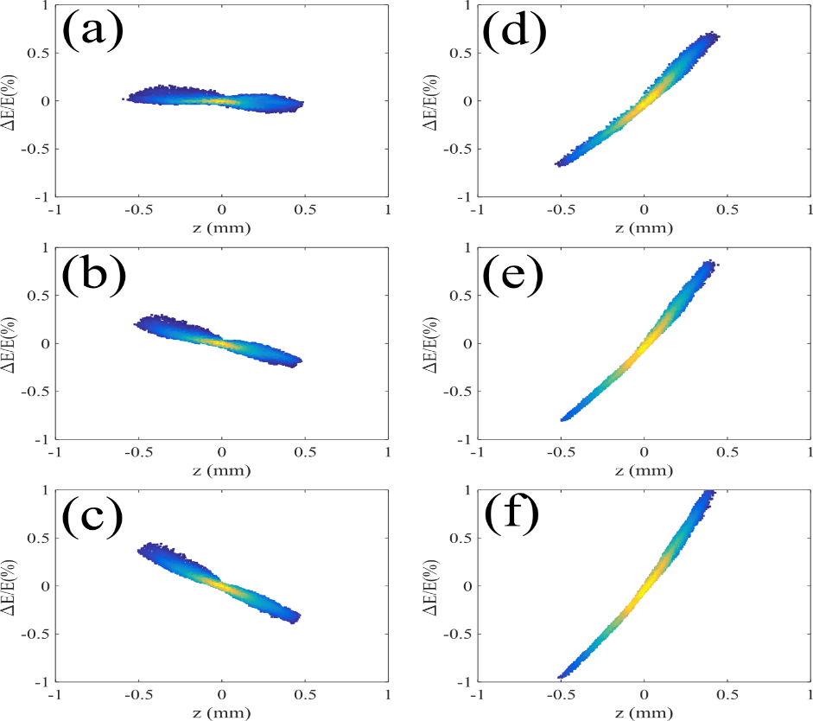

Bunch compression using double EEX
Tunable compression ration with a single quadrupole
Profiles for different compression ratios
LCLS BC1
Initial bunch length
Both lengthening and compression are possible
LCLS BC2
$$σ_{z,f}=0.2 mm$$
Tunable chirp with two quadrupoles in the middle
G. Ha et al, IPAC (2017)

Slide 26

Conclusion
EEX beamline is a powerful longitudinal phase space manipulator.
Property exchange and its application to current profile shaping are demonstrated experimentally at Argonne Wakefield Accelerator.
Nonlinear effects and collective effects on the shaping can be easily controlled, but emittance growth is a critical issue now.
Upgrade to double EEX is underway, and AWA plans to demonstrate bunch of EEX based manipulation applications.
Thank you for your attention!

